Slide 1


SQL PROJECT
text
Driven Insights using Advanced SQL Techniques
by parul kokcha

Slide 2

IntrODuction to jenson usa
-Jenson USA is a leading online cycling store in the U.S,operating for over 25 years.
-Founded in 1994.
-Founder and CEO-Michael Cachat.
-Industry-Sporting Goods Manufacturing
-Headquarters-Riverside,California

Slide 3

PROJECT : JENSON USA
My role involves studying and enhancing database
structures to improve data analysis, enabling
data-driven decision-making for business optimization.

Slide 4

Here are the findings, actions taken
for improvement, and insights :
data source :
Tools used :
Skills enforced:
SQL Query Crafting Data Analysis Insights Derivation
Jenson USA
Data
MySQL

Slide 5





Staff Performance
Sales Performance
Customer Behavior
focus
Areas
Inventory
management
store operations

Slide 6
dataset overview
stores
categories
brands
products
customers
staffs
orders
order_items
stocks

Slide 7

Key
Queries :

Slide 8


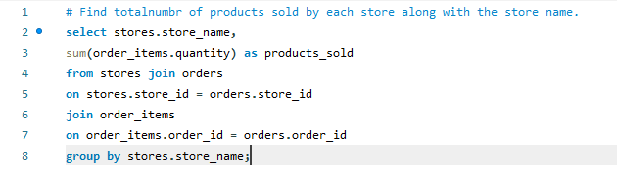
1.Find the total number of products sold by each store along with the store name.

Slide 9
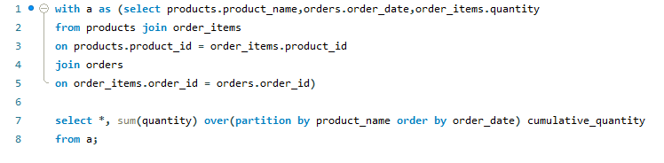
2. Calculate the cumulative sum of quantities
sold for each product over time.

Slide 10
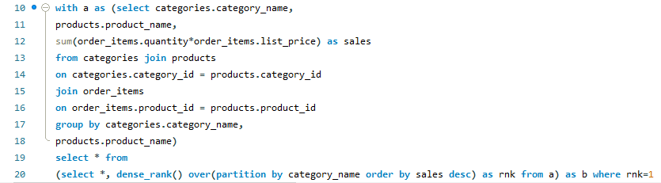
3. Find the product with the highest total sales
(quantity* price) for each category.

Slide 11
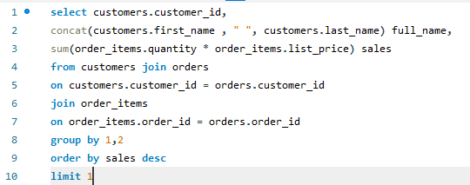
4.Find the customer who spent the
most money on orders.

Slide 12
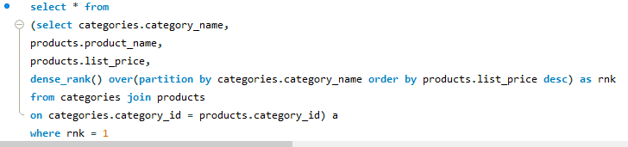
5. Find the highest priced product
for each category name.

Slide 13
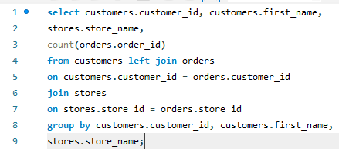
6. Find the total number of orders
placed by each customer per store.

Slide 14
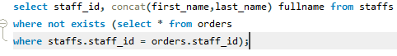
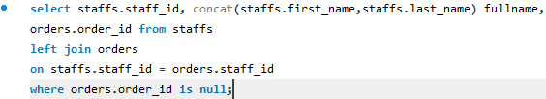
7. Find the names of staff members who
have not made any sales.

Slide 15
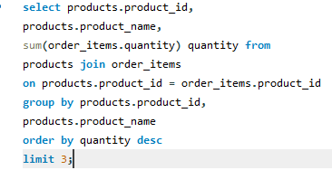
8. Find the top three most sold
products in terms of quantity.

Slide 16
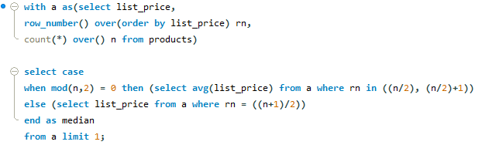
9. Find the median value of the price list.

Slide 17
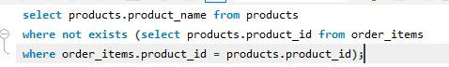
10. List all products that have
never been ordered.(Use exists)

Slide 18
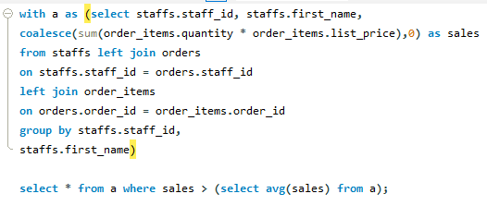
11. List the names of staff members who
have made more sales than the average
number of sales by all staff members.

Slide 19
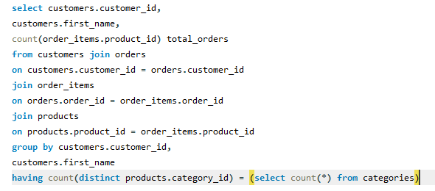
12. Identify the customers who have
ordered all types of products
( i.e, from every category).

Slide 20


conclusion
This project Jenson USA is focusing on SQL query-based problem-solving skills. It also challenges learners to analyze sales, customer behavior and staff performance using SQL. The project includes critical SQL queries like sales calculations, customer spending and staff performance analysis.

Slide 21

THANKS

